Slide 1
Welcome to Cross-Cut Game
Playing a game is our brain’s favorite way of learning.

Slide 2

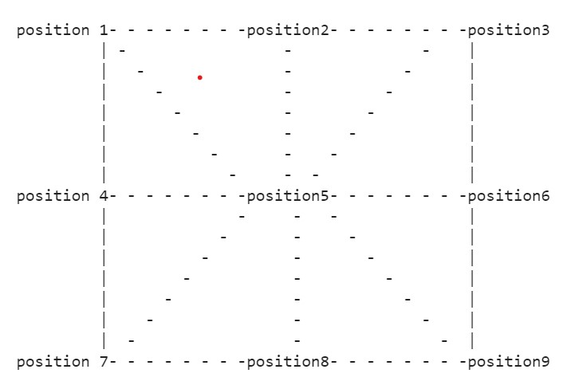
Game-Board

Slide 3
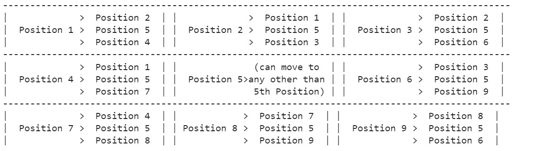
Rule-Book
Board representation:
Value 0 at any position shows that position is vacant.
Value 1 at any position shows that position is occupied by token of player 1.
Value 2 at any position shows that position is occupied by token of player 2.
Possible moving directions:

Slide 4
How to play the game
Starting of game:
At first both players have 3 move to put their token to any of the vacant position one by one.
After setting up tokens of each player, player has moves to move token one step possible move.
Possible move for player 1:
player 1 can move only from position i to position j only in possible directions mentioned above if:
-------------------------------Position i = 1 and position j=0 --------------------------------------
Possible move for player 2:
player 2 can move only from postion i to position j only in possible directions mentioned above if:
-------------------------------Position i = 2 and position j=0 --------------------------------------

Slide 5
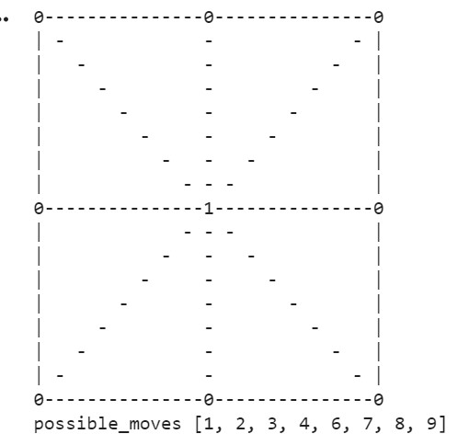
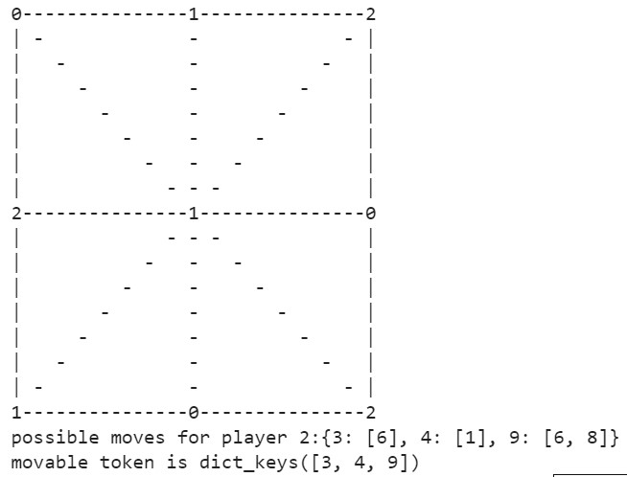
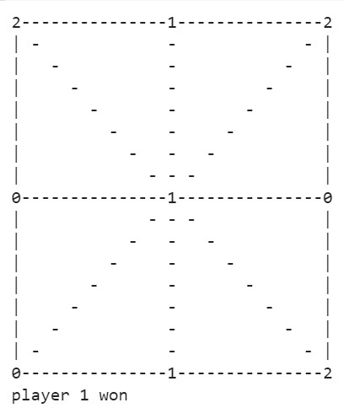
Some views of game board while playing
After first move
After 3 move
End of game

Slide 6
Thank you
Sohan Lal Yadav Rishabh Agnihotri Shyam Agarwal

